Slide 1

Report – Key Findings
Text Mining Exercise 3
Rebecka fahrni & Jessica roady

Slide 2
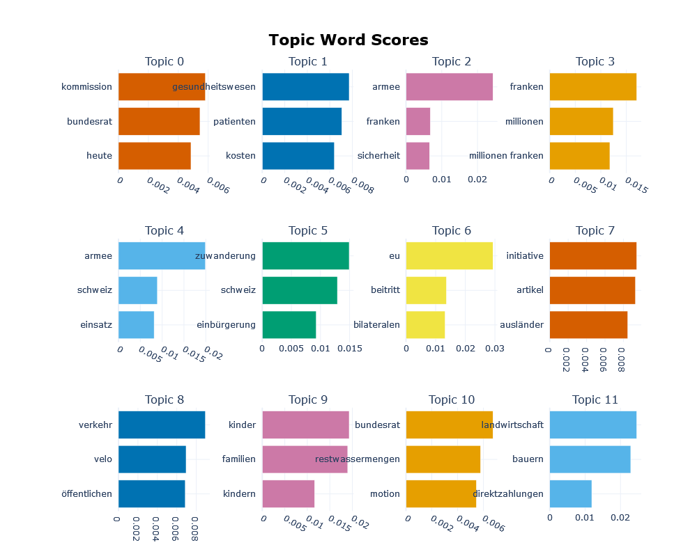
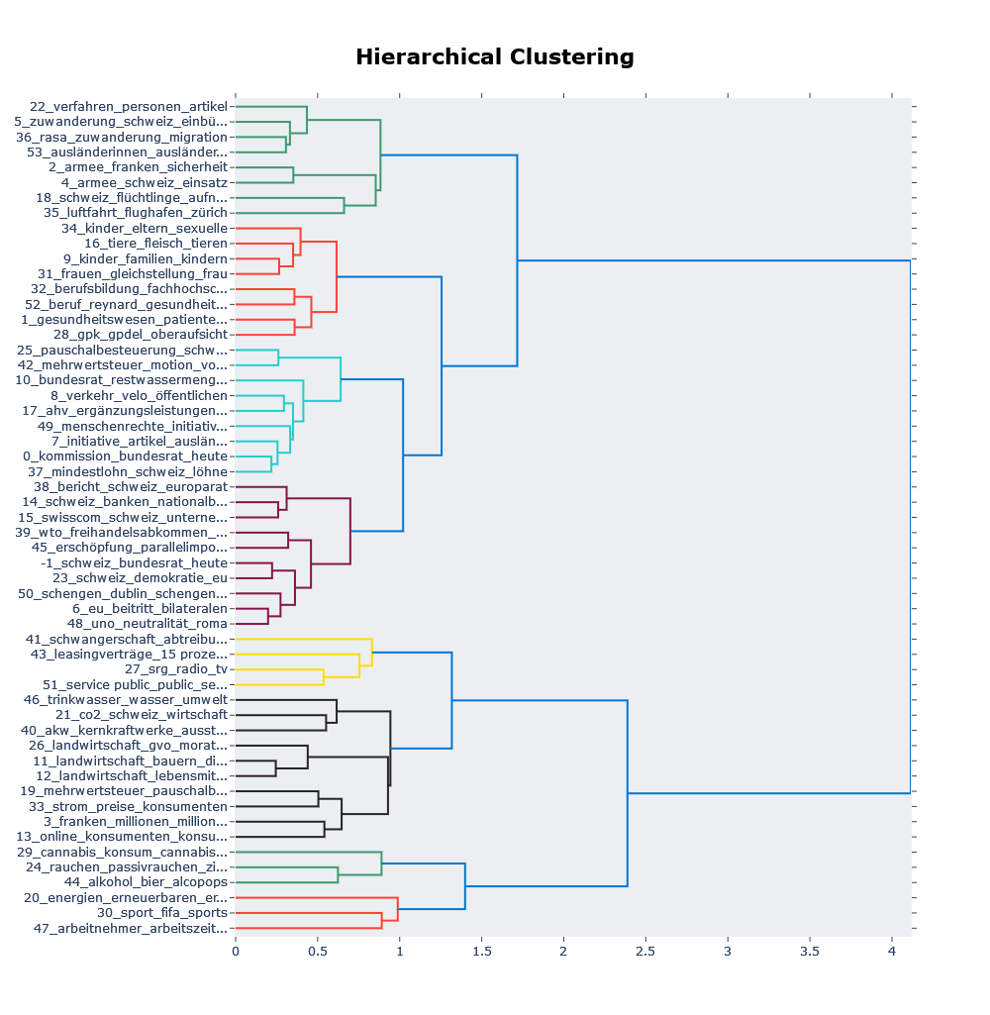
Analysis of the speeches

Slide 3
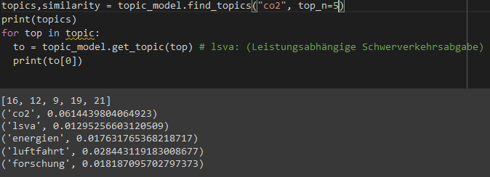
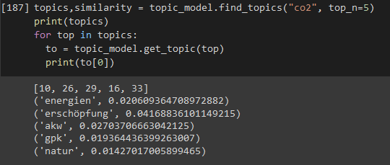
Looking for similar topics to co2
SVP
SP
Interestingly, when we search for similar topics in topic_model based on SVP vs. SP speeches, we clearly see a difference. It seems as if SVP co2-related topics focus more on lsva (Scherverkehrsabgabe = sheer traffic tax), luftfahrt (aviation) and forschung (research), which are more economy-related topics.
Topics similar to co2 in the SP speeches are very different – for example, erschöpfung (exhaustion) here is closely related to Co2.

Slide 4
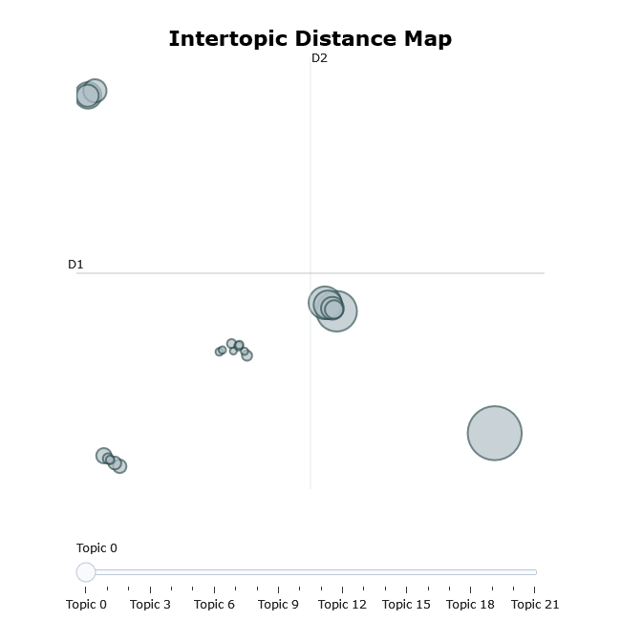
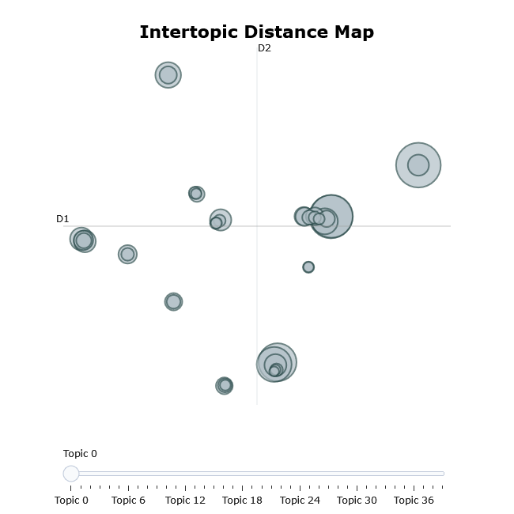
Visualize topics, sizes, and corresponding words
SVP
SP

Slide 5
Visualize topics, sizes, and corresponding words
We saw in the previous slide that the topics and their corresponding words are more diverse and spread out in the SP speeches.
Topics in the SVP speeches are more concentrated.

Slide 6
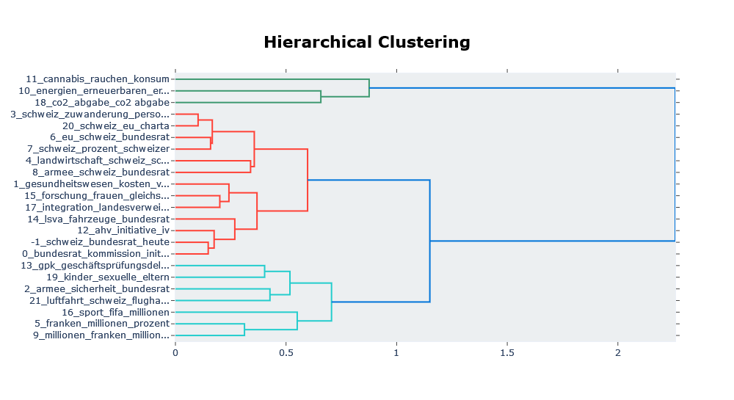
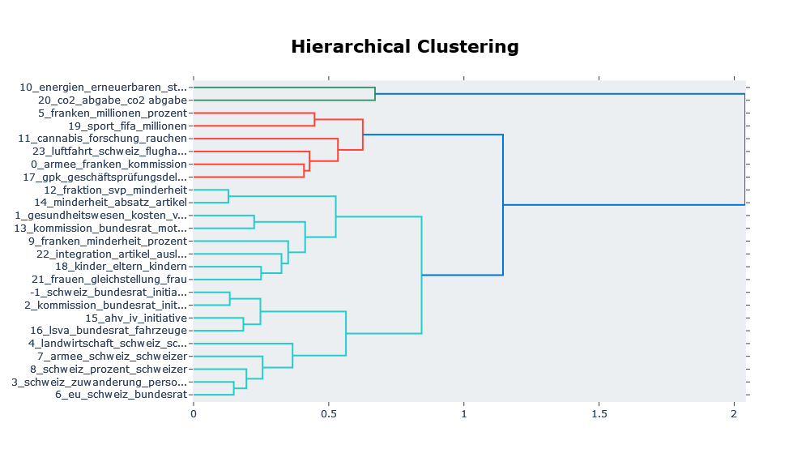
Hierarchical Clustering: Visualize Topic Hierarchy
SVP
SP

Slide 7
Hierarchical Clustering: Visualize Topic Hierarchy
We see a clear difference in the clustering of the topics.
By looking at the cut of the clustering tree, we can see a grouping of 3 colors (red, green, light blue).
The green group seems to be about energy/CO2 in the SP speeches, but according to the analysis of SVP speeches, the topic of cannabis consumption is also a part of that group. This makes the interpretation more difficult.
Interpretation of the red group is also difficult, as it seems to be about money in SP speeches but something else entirely in the SVP speeches (perhaps initiatives – Gesundheitswesen/Gleichstellung/AHV/cannabis).
Conversely, the light blue topic group in the SVP speeches seems to be more about money and in the SP speeches more about initiatives.
If we examine the groups and pick, for example, topic 5, it falls under a group related to money in both SVP and SP speeches.
According to the title and the group it falls into, topic 11 in SVP speeches seems a misfit.

Slide 8
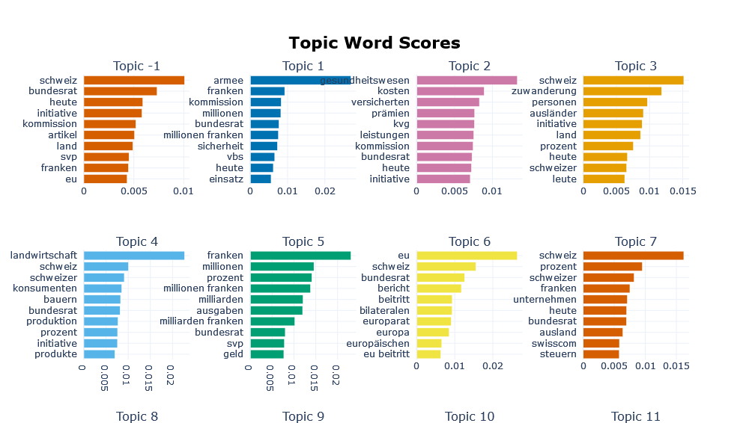
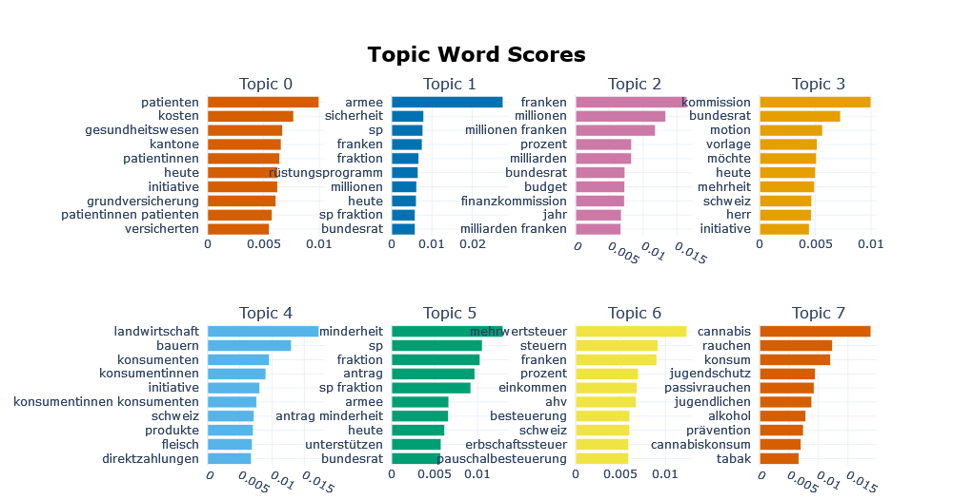
Visualize a barchart of selected topics
SVP
SP

Slide 9
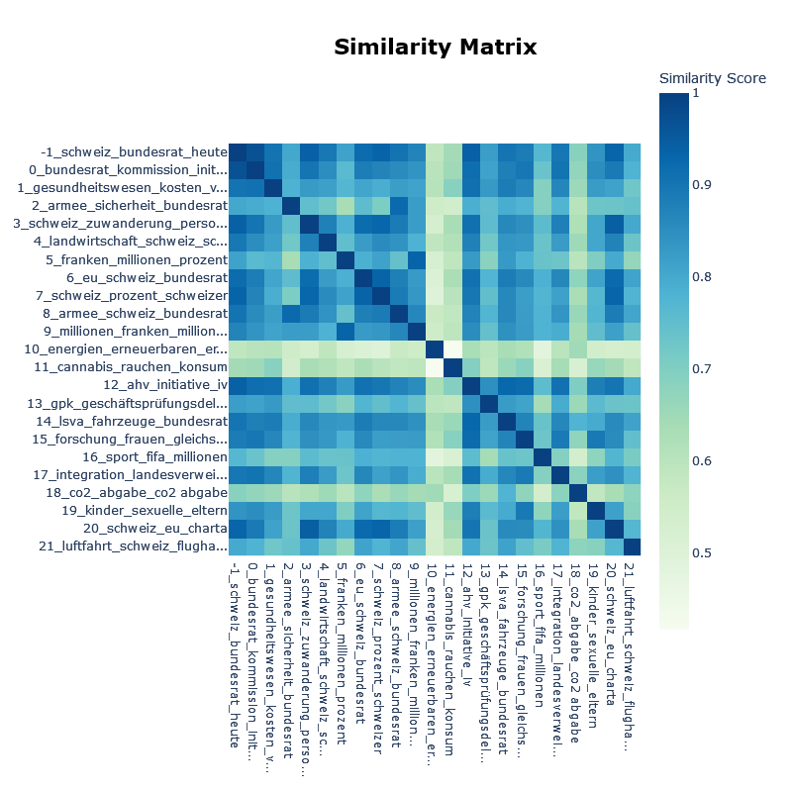
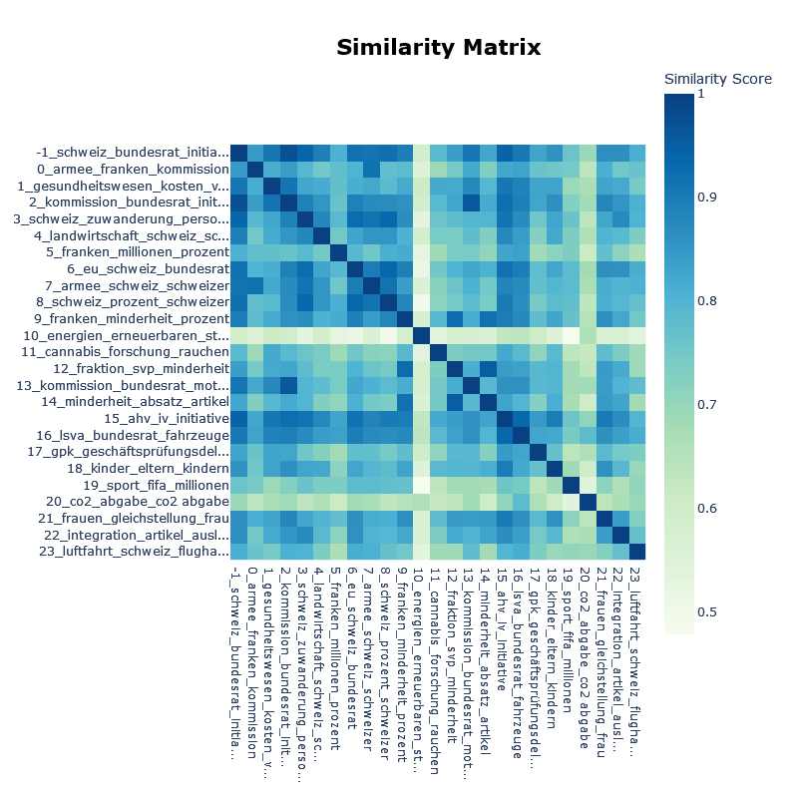
Visualize Topic Similarity
SVP
SP

Slide 10
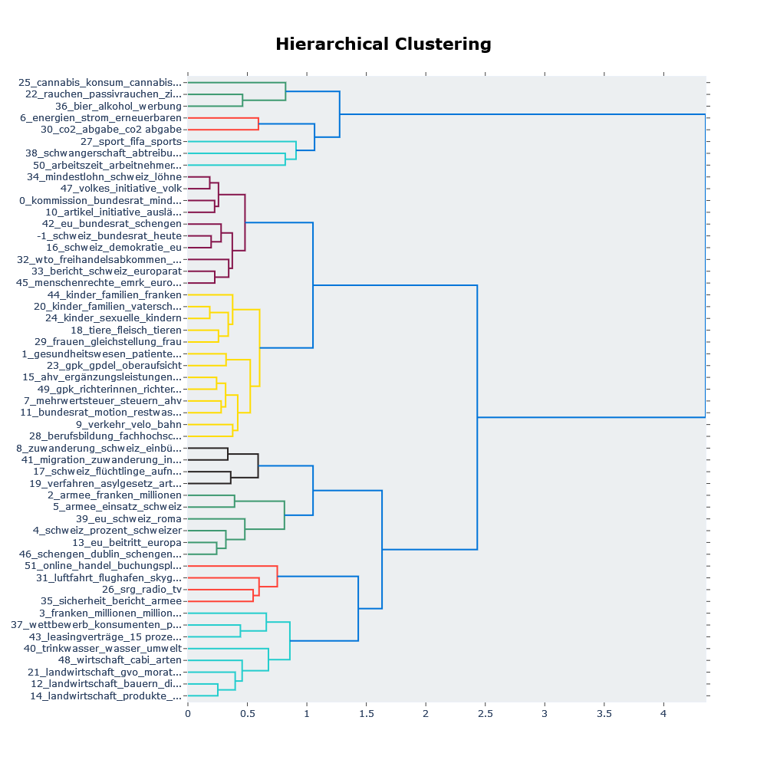
In the full dataset we see 7 groups, depending on the cut of the tree. Our interpretations of the groups would be:
Migration, energy, drugs, pregnancy vs. work, initiatives, money and economy, agriculture
Again, the interpretation of the grouping seems to be difficult:
Why is verkehr_velo_bahn (topic 9) grouped with kinder_familien_und_vaterschaft (topic 20)?
In the green group, why is passive smoking and cannabis not first grouped, but passive smoking is first clustered with beer and alcohol advertisement?

Slide 11
How well does BERTopic perform? What keywords do you think have been used to filter the speeches? How long did we take?
The keywords used in the German data are mainly nouns.
BERTopic performed pretty well, but even with 5000+ data points does not ignore stopwords.
It took about two days.

Slide 12
Problems and Difficulties
Code
large amount of data needed before stopwords disappear
topic -1 is annoying
Interpretation
trouble interpreting results, particularly from hierarchical clustering
more than plotting and seeing the differences between parties is not really possible
preserving the dates of texts would allow for diachronous modelling of topics
limiting the number of topics and keywords per topic improves intelligibility

